Slide 2
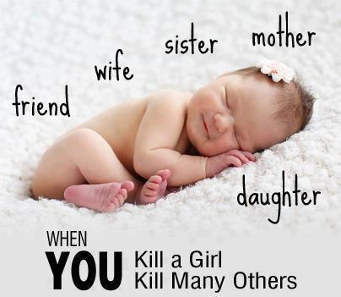

Slide 3
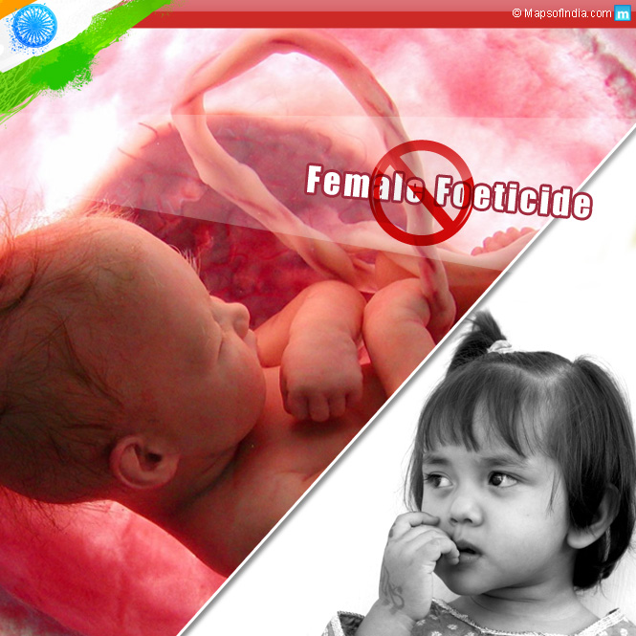
FEMALE FOETICIDE
BY
VINITHA DAVID V

Slide 5
DEFINITION
It is a practice that involves the detection of the sex of the unborn baby in the womb of the mother and the decision to abort if the sex of the fetus is detected as girl through amniocentesis, chorionic villi sampling and ultrasonography
It is the selective abortion of the female foetuses.

Slide 7
CAUSES
Illiteracy
Poverty
Socio economic status
Culture
Religious beliefs
Law and regulations
Unwanted pregnancy

Slide 9
Factors related to female foeticide
Increased availability of Advanced technologies for sex detection
Status of women
Gender discrimination
Dowry

Slide 10
Advanced technology
USG is the single most important factor responsible for increase in female feticides. In India over 25000 prenatal units are registered . Facilities for sex determination through clinic s next door are conveniently available nowadays.
The sex of the foetus can be determined at 13-14 weeks of pregnancy by TVS and by 14-16 weeks through USG. These methods have rendered early sex determination inexpensive feasible and easily accessible.

Slide 11
Status of women
The law status of Indian women coupled with gender bias is the most important factor for decreasing female sex ratio. The needs with regards to the health, nutrition and education of the girl child have been neglected. Studies report that women in south India enjoy a better status irrespective of their literacy in comparison to their North Indian counterparts.

Slide 12
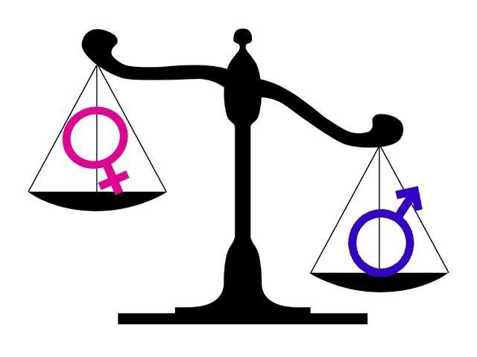
Gender discrimination
The bias against females in India is ground in its cultural, economic and religious roots. Sons are looked upon as a type of insurance. Also in a patriarchal society , sons are responsible for preservation of the family name. gender discrimination manifests itself in the form of delay in seeking the medical care and spending lesser money for treatment. The extreme disappointment of a mother as a result of a daughter’s birth can adversely affect her ability to breast feed the baby which leads to poor nutritional status of the girl child.

Slide 13
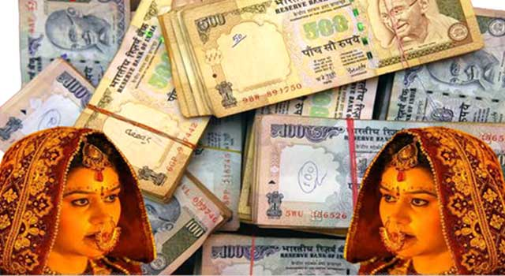
Dowry
The evil practice of dowry in India results in the consideration of daughters as an economic liability. The dowry system is more rigid in Northern states and is likely to contribute to lesser girl child ratio.

Slide 15
Strategies to curb female foeticide
Intensive education
Women empowerment
Laws
Role of medical colleges and
professional bodies.

Slide 16
Intensive education
IEC campaigns for raising awareness. The Govt has recently launched a Save the Girl Child Campaign. One of its main objective is to lessen the preference for a son by highlighting the achievements of young girls. Boys need to be educated at an early level with regard to giving respect and equal regard to girls. Involvement of community leaders as well as influential persons will increase the success of the campaign

Slide 17
Women empowerment
Education of women is a powerful tool for improving nutrition levels, raising the age at marriage, acceptance of family planning, improvement in self – image , and their empowerment. NGOs may be encouraged to promote formation of self help groups, provide counseling and support services to the newly married pregnant women to discourage them for undergoing sex selective abortion.

Slide 18
Role of medical college and professional bodies
Sensitizing the medical students regarding the adverse sex ratio while stressing upon the ethical issues involved in female feticide.
Conduct regular workshops/ CME sessions which would greatly help to reiterate the importance of the problem
Organize awareness campaigns in field practice areas.

Slide 19
PREVENTION
Prohibition of pre- sex determination tests
Free education to women up to college and even post –graduate education in Govt. run institutions.
Refuse marriage of women into households or be very careful of families the have only male children.
Do not provide incentives for families that have only males.
Provide extra incentives for families that have more than one girl child. This will help to correct the gender balance in few years.
advocacy of a scientific, rational and humanistic approach rather than superstitious beliefs.

Slide 20
Contd…
Empowerment of women and strengthening women’s right through campaigning against practices such as dowry and ensuring strict implementation of existing legislation.
Ensuring the development and access to good health care services.
Including strong ethical code of conduct among medical professionals , beginning with their training as undergraduates.
Simple methods of complaint registration , accessible to the poorest and most vulnerable women.

Slide 21
Contd..
Wide publication in the media of the scale and seriousness of the practice.
NGOs should take a key role in educating the public.
Regular assessment of indicators of status of women in society, such as sex ratio, female mortality, literacy, and economic participation.
It is only by a combination of monitoring , education campaigns, and effective legal implementation that the deep –seated attitudes and practices against women and girls can be eroded.

Slide 22
STEPS INITIATED BY GOVT.
The Govt. has initiated many steps to bring an end to this social evil , and to bring a change in the attitudes of the people in society. It is in this direction that many Laws , Acts and Schemes have been initiated like:-
The Laws Favouring Girl Education
Laws Favouring Women’s Right
The Laws Favouring Equal Property Share Of A Daughter.

Slide 23
PCPNDT ACT 2003
The first legislation against female foeticide , enacted in 1978, banned the misuse of amniocentesis in Govt. health care institutions. In 1994 , a substantial legislation, the Pre-Natal Diagnostic Techniques Act (PNDT) was adopted. The act aimed to regulate diagnostic equipment by allowing for its use only in regulated institutions. It also declared that the USG should be solely used for detecting genetic or metabolic disorders , chromosomal abnormalities etc. In 2003 the law is amended and strengthened to become the Pre Conception and Pre-Natal Diagnostic Techniques Act of 2003.

Slide 26
Thank you

